Slide 1

password_checker.c
A quick way to evaluate login credentials saved in the browser.
By: Derek Walker

Slide 2

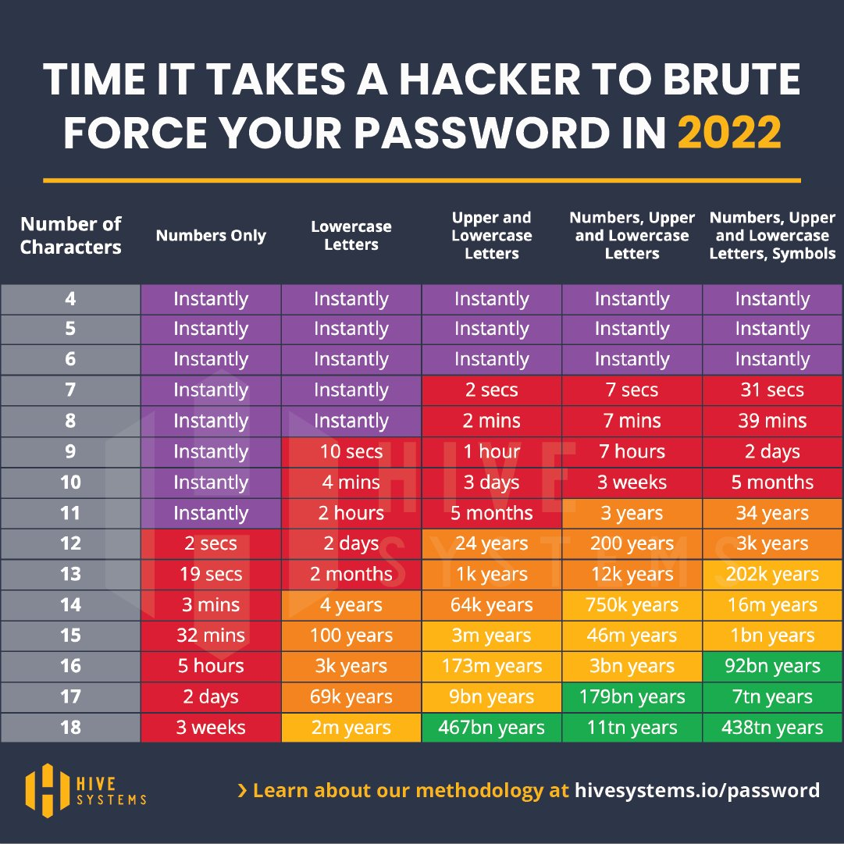
Password Problems
Short passwords, while easily remembered, are also easily guessed or "brute-forced" with the aid of software.
Old passwords are more likely to have been included in a previous data breach.
Routinely creating new, long and complex passwords can be burdensome without a password manager.

Slide 3
Creating and remembering many long, complex and unique passwords can be difficult.
Many people still see the use of password managers and MFA as an obstacle, rather than tools to improve security.
To save time when logging in online, many people will let their browsers save their credentials for them.
Password Problems (cont.)

Slide 4
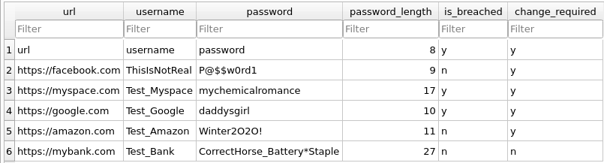
How do I know if my passwords are safe? Using password_checker.c
password_checker.c parses the .csv file your browser saves when exporting your saved credentials
password_checker.c then compares the saved password against a common wordlist used by attackers called rockyou.txt
If your password is too short (less than 16 characters), or has been found in the rockyou list, password_checker.c will notify you what that password was, and to which website it belongs when advising which passwords should be changed.
password_checker.c then stores all credentials found in the logins.csv file in a sqlite database for further review

